Slide 1
Geometrical Interpretation of SVD
-Nidhi Sangwan

Slide 2
Transformations
Transformations on a plane or space can be seen as functions that take points to other points
Scaling
Stretch (or Compress) horizontally
Stretch (or Compress) vertically
Rotate
By rotating and scaling we can mimic every linear transformation

Slide 3
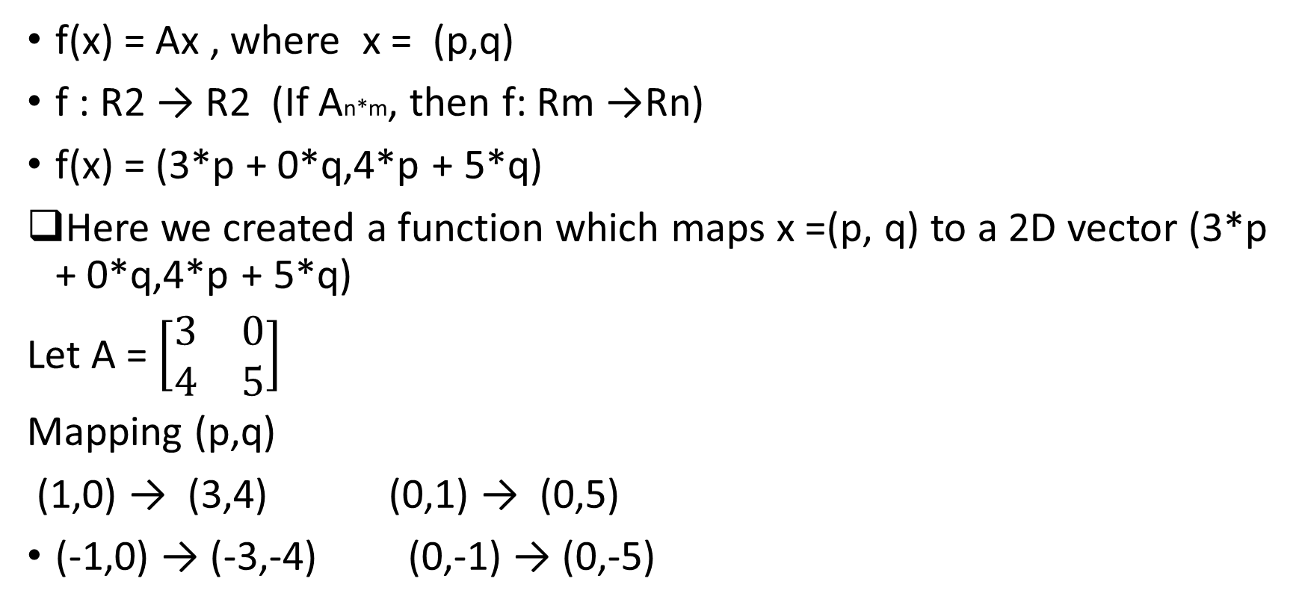
Linear transformations
f(x) = Ax , where x = (p,q)
f : R2 → R2 (If An*m, then f: Rm →Rn)
f(x) = (3*p + 0*q,4*p + 5*q)
Here we created a function which maps x =(p, q) to a 2D vector (3*p + 0*q,4*p + 5*q)
Let A = $\left[\begin{matrix}3 & 0 \\ 4 & 5\end{matrix}\right]$
Mapping (p,q)
(1,0) → (3,4) (0,1) → (0,5)
(-1,0) → (-3,-4) (0,-1) → (0,-5)

Slide 4
Linear transformation
(p,q)
(3*p + 0*q,4*p + 5*q)
The transformation turned unit circle into ellipse

Slide 5
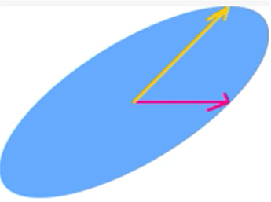
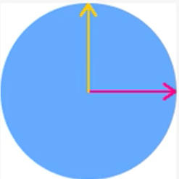
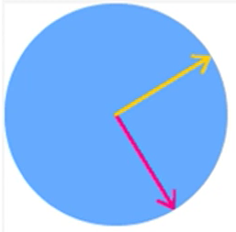
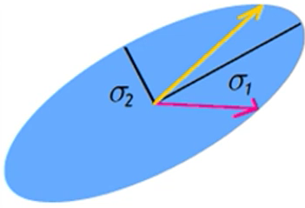
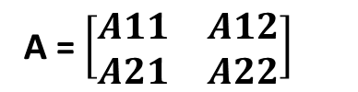
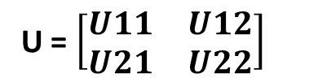
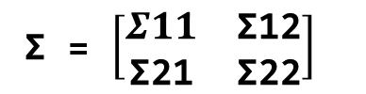
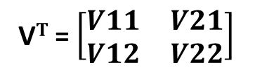
SVD
A = $\left[\begin{matrix}A11 & A12 \\ A21 & A22\end{matrix}\right]$
V$T$ = $\left[\begin{matrix}V11 & V21 \\ V12 & V22\end{matrix}\right]$
Σ = $\left[\begin{matrix}Σ11 & \text{Σ}\text{12} \\ \text{Σ}\text{21} & \text{Σ}\text{22}\end{matrix}\right]$
U = $\left[\begin{matrix}U11 & U12 \\ U21 & U22\end{matrix}\right]$

Slide 6
SVD is a method of decomposing matrix into other matrices A = UΣV*
import numpy as np
A = np.array([[3,0],[4,5]])
print(np.linalg.svd(A))
Matrix U:
array([[-0.31622777, -0.9486833 ], [-0.9486833 , 0.31622777]]
Diagonal entries of Σ :
array([6.70820393, 2.23606798])
Matrix Transpose(V):
array([[-0.70710678, -0.70710678], [-0.70710678, 0.70710678]]

Slide 7
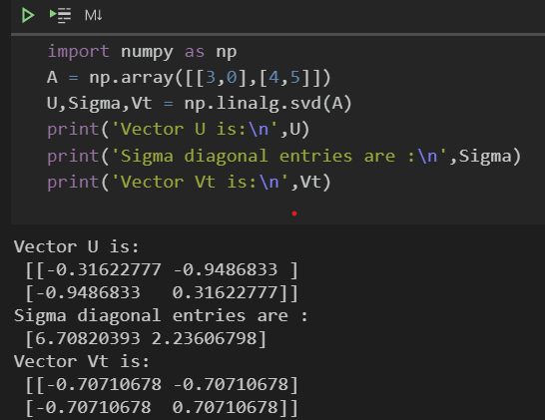
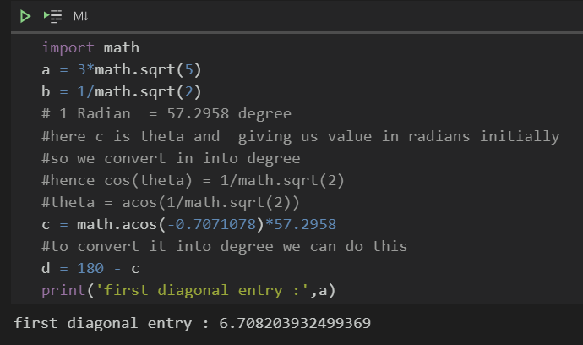
Numpy to get U V and diagonal entries

Slide 8
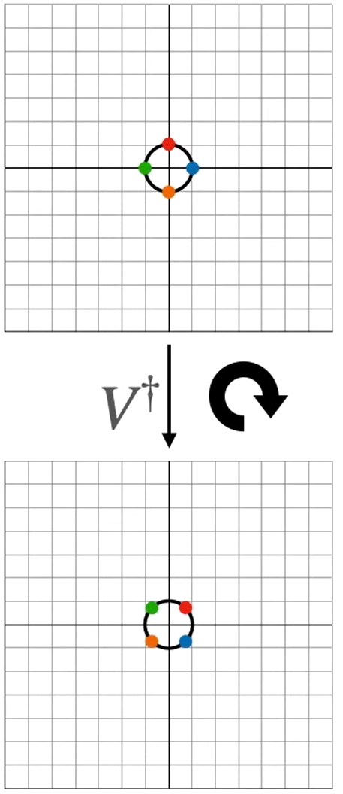
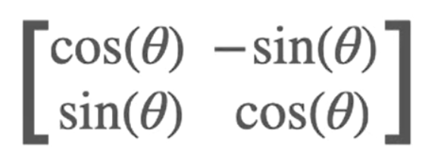
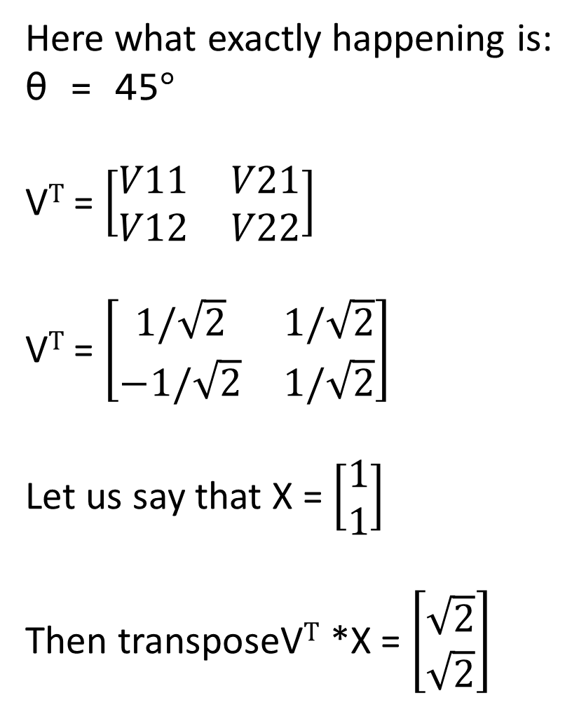
Here what exactly happening is:
θ = 45$°$
V$T$ = $\left[\begin{matrix}V11 & V21 \\ V12 & V22\end{matrix}\right]$
V$T$ = $\left[\begin{matrix}1/\sqrt{2} & 1/\sqrt{2} \\ −1/\sqrt{2} & 1/\sqrt{2}\end{matrix}\right]$
Let us say that X = $\left[\begin{aligned}1 \\ 1\end{aligned}\right]$
Then transposeV$T$ *X = $\left[\begin{aligned}\sqrt{2} \\ \sqrt{2}\end{aligned}\right]$

Slide 9
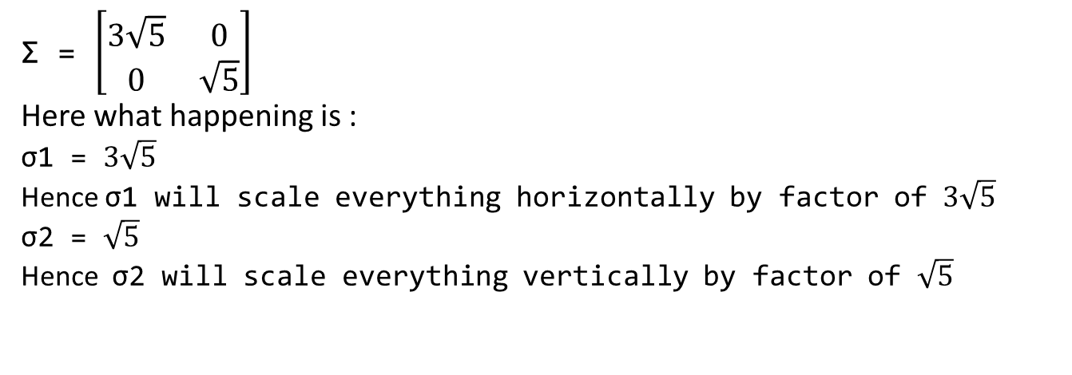
Σ = $\left[\begin{matrix}3\sqrt{5} & \text{0} \\ 0 & \sqrt{5}\end{matrix}\right]$
Here what happening is :
σ1 = $3\sqrt{5}$
Hence σ1 will scale everything horizontally by factor of $3\sqrt{5}$
σ2 = $\sqrt{5}$
Hence σ2 will scale everything vertically by factor of $\sqrt{5}$

Slide 10
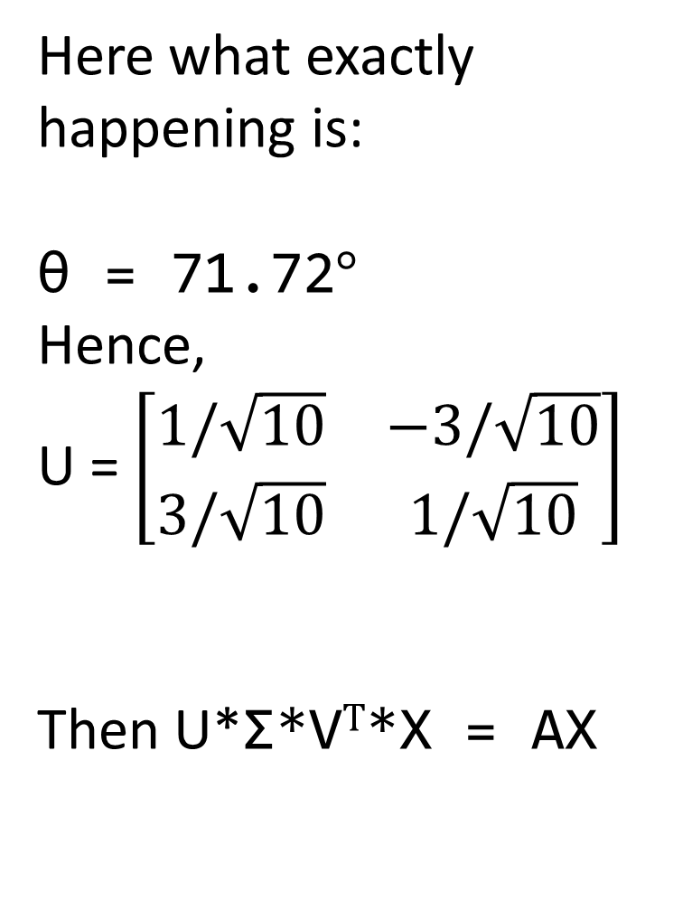
Here what exactly happening is:
θ = 71.72$°$
Hence,
U = $\left[\begin{matrix}1/\sqrt{10} & −3/\sqrt{10} \\ 3/\sqrt{10} & 1/\sqrt{10}\end{matrix}\right]$
Then U*Σ*V$T$*X = AX

Slide 11
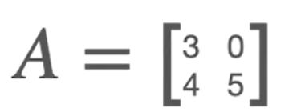
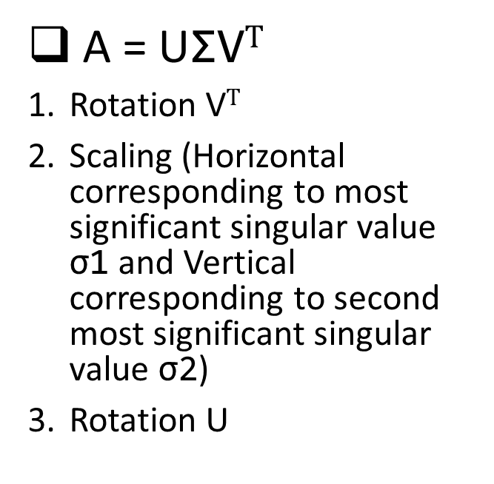
The transformation turned unit circle into ellipse
Summary
A = UΣV$T$
Rotation V$T$
Scaling (Horizontal corresponding to most significant singular value σ1 and Vertical corresponding to second most significant singular value σ2)
Rotation U

